Slide 1

PHASE 4 Dynasty CARS

Slide 2
01
Decision-Making
03
Output
Output
04
Hardware
05
Logic and formulas used
02
Database
Meets project requirements
Purpose
Organization/design
What’s included

Slide 3
06
Software
07
User Interface
08
Attention to Details
09
Teamwork
What’s included
Design/End User
Project Life cycle
Team Roles

Slide 4

01 Decision Making
What’s the project?
What Language?
Responsibilities
Communication

Slide 5
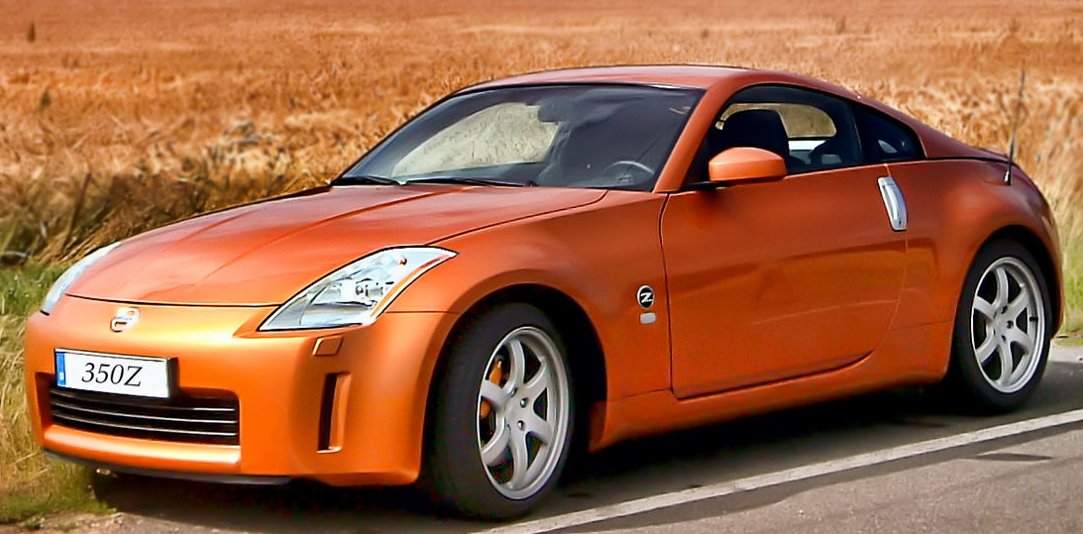
Database
02-0
Cylinder and Transmission
https://www.teoalida.com/cardatabase/
Excel
Details – Make, Model, Year,
Body Type, Exterior Color, Cylinders, Transmission
Make
Model
Exterior Color

Slide 6

PROBLEM For Customers
02-1
To create a user-friendly program. The
Database had to be simple. Too many options would make the system complicated and users would be less likely to use it.

Slide 7

PROBLEM for Administrators
02-2
The Administrators would be able to have all the information the customer would have, and the ability to add a new car to the Database.
We had to make this simple as well. So it would go into the Database correctly

Slide 8
Output/Serves Intended Purpose
03-0
Our task was to create an inventory system that allowed a user or users to easily search Dynasty Cars’ car lot.
We did this by writing a program that interacted with a database which held all the necessary data on each vehicle in order to perform a search function.
We were successful. The product allows a user to easily search the car lot using a simple drop-down menu.
There is added functionality of an Admin user being able to add and remove cars from the database manually as well as being able to view the entire inventory at once.

Slide 9
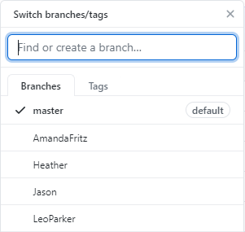
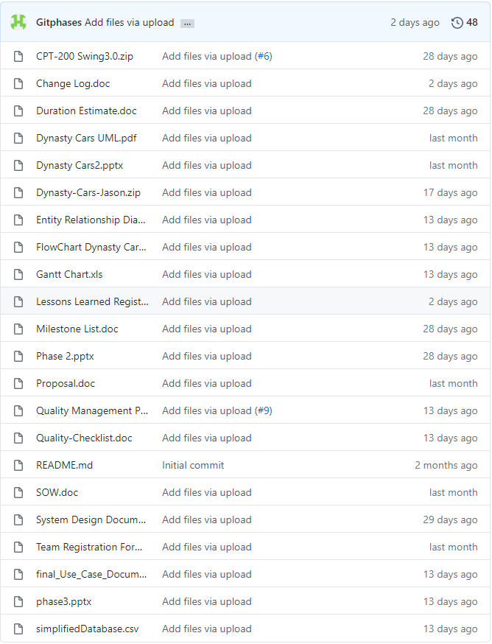
Output/Organization
GitHub
04-0
We have one Master branch and one sub-branch for each team member.
All additions to the project were uploaded to the contributor's sub-branch before being reviewed and ultimately committed to the Master.

Slide 10

Hardware
05-0
Computer: OptiPlex 3070
Monitor: Dell 24” E2420HS
Mouse: Dell MS116 Wired
Keyboard: Dell KB216
Security: None – All local data
Warranty: Five Years ProSupport

Slide 11
Hardware Specifications
05-1
Computer Specifications(Guest):
CPU: Intel Core i3-9100
GPU: Intel Integrated Graphics
RAM: 4GB of 2666MHz DDr4 Memory
Storage: 3.5” 500GB SATA HDD
OS: Windows 10 Pro 64 Bit
Price Per Unit: $910.09
Computer Specifications(Admin):
CPU: Intel Core i3-9100
GPU: Intel Integrated Graphics
RAM: 32GB of 3200MHz DDr4 Memory
Storage: Seagate BarraCuda 1TB SSD
OS: Windows 10 Pro 64 Bit
Price Per Unit: $1100.75

Slide 12







Software
06-0
Applications
Tools
Eclipse IDE
Java JDK
Swing
Window Builder
PowerPoint
Excel
Abstract Window Toolkit

Slide 13
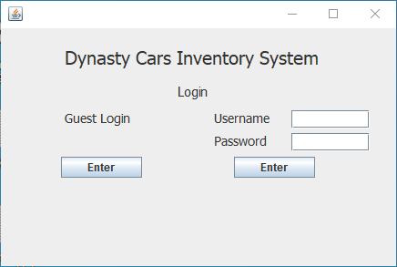
User Interface
07-0

Slide 14
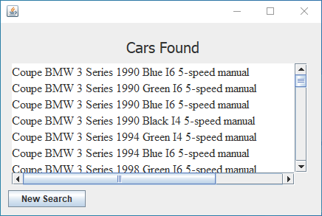
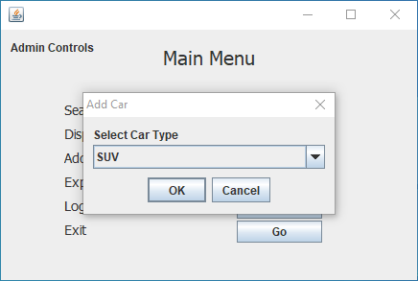
Well Designed
07-1
Easy to read
Scrollbars
Pop-ups for adding new cars

Slide 15
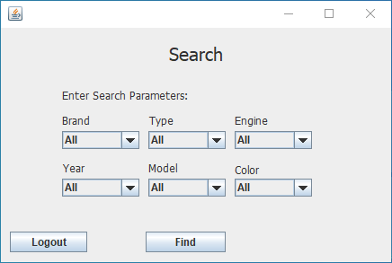
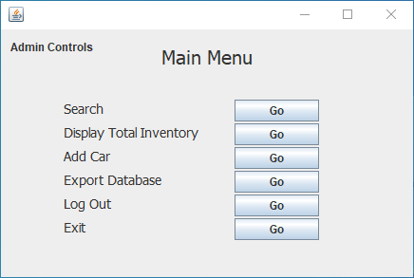
Intuitive Design
07-2
Headers
Descriptions for buttons and dropdowns

Slide 16
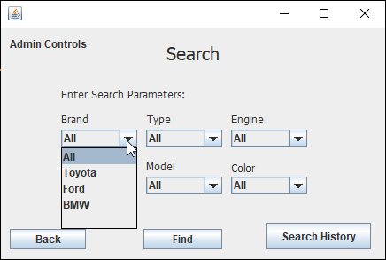
Intuitive Design
07-3
Drop downs auto-populate with valid values
Update when adding new vehicles

Slide 17

Attention To Detail
08-0
Product Side
As a consumer, we all took into consideration of what we look for when searching for a car
Also what is visually appealing to the eye. App color, placement, search ability, individual frames vs the same frame.

Slide 18
Attention to Detail
Time Management
Organized
Accuracy/ Technical
08-1
Skills and Attributes
Setting goals, prioritizing your goals, planning, creating a schedule
Daily contact, management software, Master branch managed/cleanup daily of only necessary documents
Familiarity with Java/programming language.
Trials of different situation tested to ensure the system was running as it should

Slide 19
TEAMWORK Tuckman Ladder Team Development Model
09-0
Forming Stage- After the first 2 weeks, we found that each team member had a vital set of different skills to make this project a success
Storming Stage- Everyone put their strengths forward, holding themselves accountable, and were not afraid to ask for help since they respect one another.
Norming Stage-All ideas started to come together and we all agreed on what we wanted for a finished product.
Performing Stage- Poor communication is the leading cause of failed projects, in the beginning we did have our moments but in the end everyone on the team went above and beyond what was expected
Adjourning Stage- team as a whole is satisfied with the projects deliverables, closes project.

Slide 20




TEAMWORK
Amanda Fritz-Operations Admin Specialist
Heather Ryan -Project Manager
09-1
Leo Parker- R & D, GUI setup, coding
Jason Murley-Developer

Slide 21

Questions???
Template created by Slidesgol

